Slide 1



Software Engineering
WEEK 4
ENGR. Muhammad UMER HAROON

Slide 2

WEEK 4

Slide 3
A test case example
<?php
function test_addition()
{
$result = addition(1, 2);
if ($result !== 3) {
throw new Exception("1 + 2 should equal 3, but got {$result}");
}
}

Slide 4
Write code to pass the test

Slide 5
The code
<?php
function addition($a, $b)
{
return $a + $b;
}

Slide 7
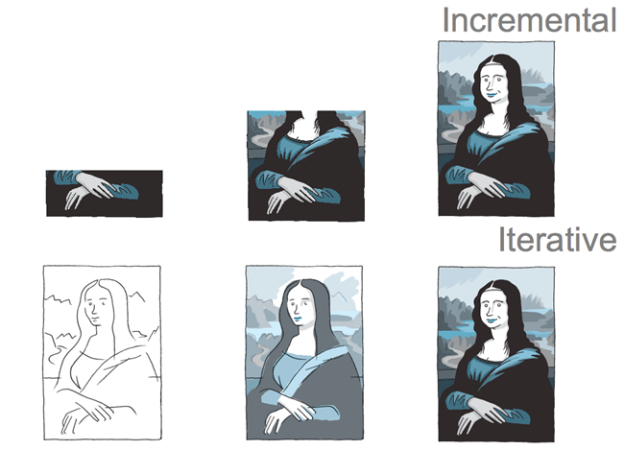

Slide 8
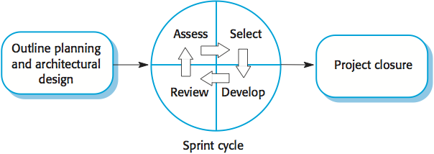
Scrum
Scrum is an agile method that focuses on managing iterative development rather than specific agile practices.
There are three phases in Scrum.
The initial phase is an outline planning phase where you establish the general objectives for the project and design the software architecture.
This is followed by a series of sprint cycles, where each cycle develops an increment of the system.
The project closure phase wraps up the project, completes required documentation such as system help frames and user manuals and assesses the lessons learned from the project.

Slide 9
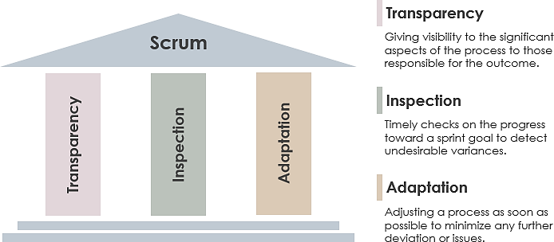
Three pillars of scrum

Slide 10
Scrum terminology (a)
Scrum term | Definition
Development team | A self-organizing group of software developers, which should be no more than 7 people. They are responsible for developing the software and other essential project documents.
Potentially shippable product increment | The software increment that is delivered from a sprint. The idea is that this should be ‘potentially shippable’ which means that it is in a finished state and no further work, such as testing, is needed to incorporate it into the final product. In practice, this is not always achievable.
Product backlog | This is a list of ‘to do’ items which the Scrum team must tackle. They may be feature definitions for the software, software requirements, user stories or descriptions of supplementary tasks that are needed, such as architecture definition or user documentation.
Product owner | An individual (or possibly a small group) whose job is to identify product features or requirements, prioritize these for development and continuously review the product backlog to ensure that the project continues to meet critical business needs. The Product Owner can be a customer but might also be a product manager in a software company or other stakeholder representative.

Slide 11
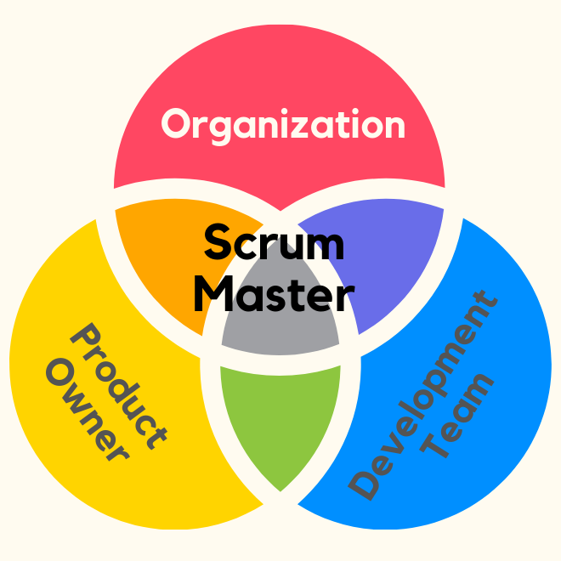
Scrum terminology (b)
The ScrumMaster acts as a servant-leader, helping the team to deliver the best possible product increment in each sprint.
In this way, the ScrumMaster is different from a traditional project manager, who is often responsible for controlling and directing the project.
Scrum term | Definition
Scrum | A daily meeting of the Scrum team that reviews progress and prioritizes work to be done that day. Ideally, this should be a short face-to-face meeting that includes the whole team.
ScrumMaster | The ScrumMaster is responsible for ensuring that the Scrum process is followed and guides the team in the effective use of Scrum. He or she is responsible for interfacing with the rest of the company and for ensuring that the Scrum team is not diverted by outside interference. The Scrum developers are adamant that the ScrumMaster should not be thought of as a project manager. Others, however, may not always find it easy to see the difference.
Sprint | A development iteration. Sprints are usually 2-4 weeks long.
Velocity | An estimate of how much product backlog effort that a team can cover in a single sprint. Understanding a team’s velocity helps them estimate what can be covered in a sprint and provides a basis for measuring improving performance.

Slide 12
Scrum sprint cycle

Slide 13
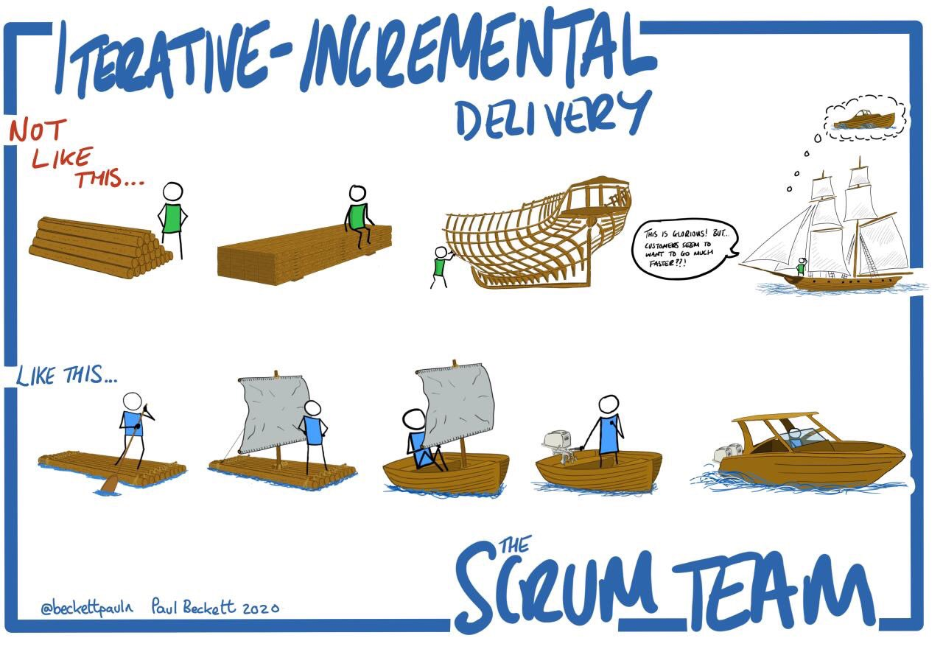

Slide 14
The Scrum sprint cycle
Sprints are fixed length, normally 2–4 weeks.
The starting point for planning is the product backlog, which is the list of work to be done on the project.
The selection phase involves all of the project team who work with the customer to select the features and functionality from the product backlog to be developed during the sprint.

Slide 15
The Sprint cycle
Once these are agreed, the team organize themselves to develop the software.
During this stage the team is isolated from the customer and the organization, with all communications channelled through the so-called ‘Scrum master’.
The role of the Scrum master is to protect the development team from external distractions.
At the end of the sprint, the work done is reviewed and presented to stakeholders. The next sprint cycle then begins.

Slide 16
Teamwork in Scrum
The ‘Scrum master’ is a facilitator who arranges daily meetings, tracks the backlog of work to be done, records decisions, measures progress against the backlog and communicates with customers and management outside of the team.
The whole team attends short daily meetings (Scrums) where all team members share information, describe their progress since the last meeting, problems that have arisen and what is planned for the following day.
This means that everyone on the team knows what is going on and, if problems arise, can re-plan short-term work to cope with them.

Slide 17
Scrum benefits
The product is broken down into a set of manageable and understandable chunks.
Unstable requirements do not hold up progress.
The whole team have visibility of everything and consequently team communication is improved.
Customers see on-time delivery of increments and gain feedback on how the product works.
Trust between customers and developers is established and a positive culture is created in which everyone expects the project to succeed.

Slide 18
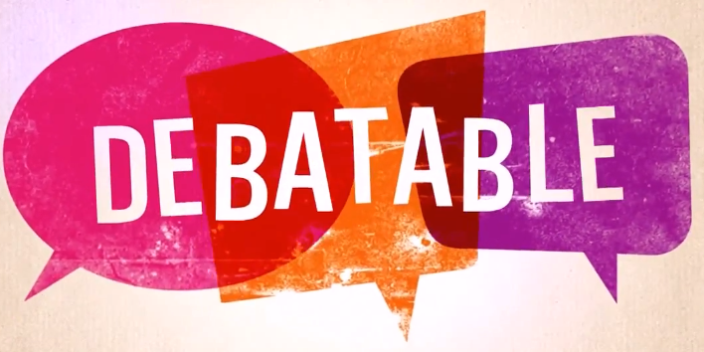
Distributed Scrum
Distributed Scrum is a method of implementing the Scrum framework in a distributed or remote setting, where team members are located in different geographic locations or work from different sites. In a distributed Scrum environment, the team must overcome the challenges of coordinating work and communicating effectively across different time zones, cultures, and languages.

Slide 19
Scaling agile methods

Slide 20
Scaling agile methods
Agile methods have proved to be successful for small and medium sized projects that can be developed by a small co-located team.
It is sometimes argued that the success of these methods comes because of improved communications which is possible when everyone is working together.
Scaling up agile methods involves changing these to cope with larger, longer projects where there are multiple development teams, perhaps working in different locations.

Slide 21
Scaling out and scaling up
‘Scaling up’ is concerned with using agile methods for developing large software systems that cannot be developed by a small team.
‘Scaling out’ is concerned with how agile methods can be introduced across a large organization with many years of software development experience.
When scaling agile methods it is importaant to maintain agile fundamentals:
Flexible planning, frequent system releases, continuous integration, test-driven development and good team communications.

Slide 22
Practical problems with agile methods
The informality of agile development is incompatible with the legal approach to contract definition that is commonly used in large companies.
Agile methods are most appropriate for new software development rather than software maintenance. Yet the majority of software costs in large companies come from maintaining their existing software systems.
Agile methods are designed for small co-located teams yet much software development now involves worldwide distributed teams.

Slide 23
Contractual issues
Most software contracts for custom systems are based around a specification, which sets out what has to be implemented by the system developer for the system customer.
However, this precludes interleaving specification and development as is the norm in agile development.
A contract that pays for developer time rather than functionality is required.
However, this is seen as a high risk my many legal departments because what has to be delivered cannot be guaranteed.

Slide 24
Agile methods and software maintenance
Most organizations spend more on maintaining existing software than they do on new software development. So, if agile methods are to be successful, they have to support maintenance as well as original development.
Two key issues:
Are systems that are developed using an agile approach maintainable, given the emphasis in the development process of minimizing formal documentation?
Can agile methods be used effectively for evolving a system in response to customer change requests?
Problems may arise if original development team cannot be maintained.

Slide 25
Agile maintenance
Key problems are:
Lack of product documentation
Keeping customers involved in the development process
Maintaining the continuity of the development team
Agile development relies on the development team knowing and understanding what has to be done.
For long-lifetime systems, this is a real problem as the original developers will not always work on the system.

Slide 26
Agile and plan-driven methods
Most projects include elements of plan-driven and agile processes. Deciding on the balance depends on:
Is it important to have a very detailed specification and design before moving to implementation? If so, you probably need to use a plan-driven approach.
Is an incremental delivery strategy, where you deliver the software to customers and get rapid feedback from them, realistic? If so, consider using agile methods.
How large is the system that is being developed? Agile methods are most effective when the system can be developed with a small co-located team who can communicate informally. This may not be possible for large systems that require larger development teams so a plan-driven approach may have to be used.

Slide 27

When ever this uncle appears
You are supposed to
Read that content your self

Slide 28
Agile principles and organizational practice
Principle | Practice
Customer involvement | This depends on having a customer who is willing and able to spend time with the development team and who can represent all system stakeholders. Often, customer representatives have other demands on their time and cannot play a full part in the software development. Where there are external stakeholders, such as regulators, it is difficult to represent their views to the agile team.
Embrace change | Prioritizing changes can be extremely difficult, especially in systems for which there are many stakeholders. Typically, each stakeholder gives different priorities to different changes.
Incremental delivery | Rapid iterations and short-term planning for development does not always fit in with the longer-term planning cycles of business planning and marketing. Marketing managers may need to know what product features several months in advance to prepare an effective marketing campaign.

Slide 29
Agile principles and organizational practice
Principle | Practice
Maintain simplicity | Under pressure from delivery schedules, team members may not have time to carry out desirable system simplifications.
People not process | Individual team members may not have suitable personalities for the intense involvement that is typical of agile methods, and therefore may not interact well with other team members.

Slide 30
Agile and plan-based factors

Slide 31
System issues
How large is the system being developed?
Agile methods are most effective a relatively small co-located team who can communicate informally.
What type of system is being developed?
Systems that require a lot of analysis before implementation need a fairly detailed design to carry out this analysis.
What is the expected system lifetime?
Long-lifetime systems require documentation to communicate the intentions of the system developers to the support team.
Is the system subject to external regulation?
If a system is regulated you will probably be required to produce detailed documentation as part of the system safety case.

Slide 32
People and teams
How good are the designers and programmers in the development team?
It is sometimes argued that agile methods require higher skill levels than plan-based approaches in which programmers simply translate a detailed design into code.
How is the development team organized?
Design documents may be required if the team is distributed.
What support technologies are available?
IDE support for visualisation and program analysis is essential if design documentation is not available.

Slide 33
Organizational issues
Traditional engineering organizations have a culture of plan-based development, as this is the norm in engineering.
Is it standard organizational practice to develop a detailed system specification?
Will customer representatives be available to provide feedback of system increments?
Can informal agile development fit into the organizational culture of detailed documentation?

Slide 34
Agile methods for large systems
Large systems are usually collections of separate, communicating systems, where separate teams develop each system. Frequently, these teams are working in different places, sometimes in different time zones.
Large systems are ‘brownfield systems’, that is they include and interact with a number of existing systems. Many of the system requirements are concerned with this interaction and so don’t really lend themselves to flexibility and incremental development.
Where several systems are integrated to create a system, a significant fraction of the development is concerned with system configuration rather than original code development.

Slide 35
Large system development
Large systems and their development processes are often constrained by external rules and regulations limiting the way that they can be developed.
Large systems have a long procurement and development time. It is difficult to maintain coherent teams who know about the system over that period as, inevitably, people move on to other jobs and projects.
Large systems usually have a diverse set of stakeholders. It is practically impossible to involve all of these different stakeholders in the development process.

Slide 36
Factors in large systems

Slide 37
Scaling up to large systems
A completely incremental approach to requirements engineering is impossible.
There cannot be a single product owner or customer representative.
For large systems development, it is not possible to focus only on the code of the system.
Cross-team communication mechanisms have to be designed and used.
Continuous integration is practically impossible. However, it is essential to maintain frequent system builds and regular releases of the system.

Slide 38
Multi-team Scrum
"Multi-team Scrum" refers to the approach of using the Scrum framework to manage multiple teams working on a single project. In this approach, each team has its own Scrum Master and Product Owner, but they all work together to deliver a single product.
Role replication
Each team has a Product Owner for their work component and ScrumMaster.
Product architects
Each team chooses a product architect and these architects collaborate to design and evolve the overall system architecture.
Release alignment
The dates of product releases from each team are aligned so that a demonstrable and complete system is produced.
Scrum of Scrums
There is a daily Scrum of Scrums where representatives from each team meet to discuss progressand plan work to be done.

Slide 39
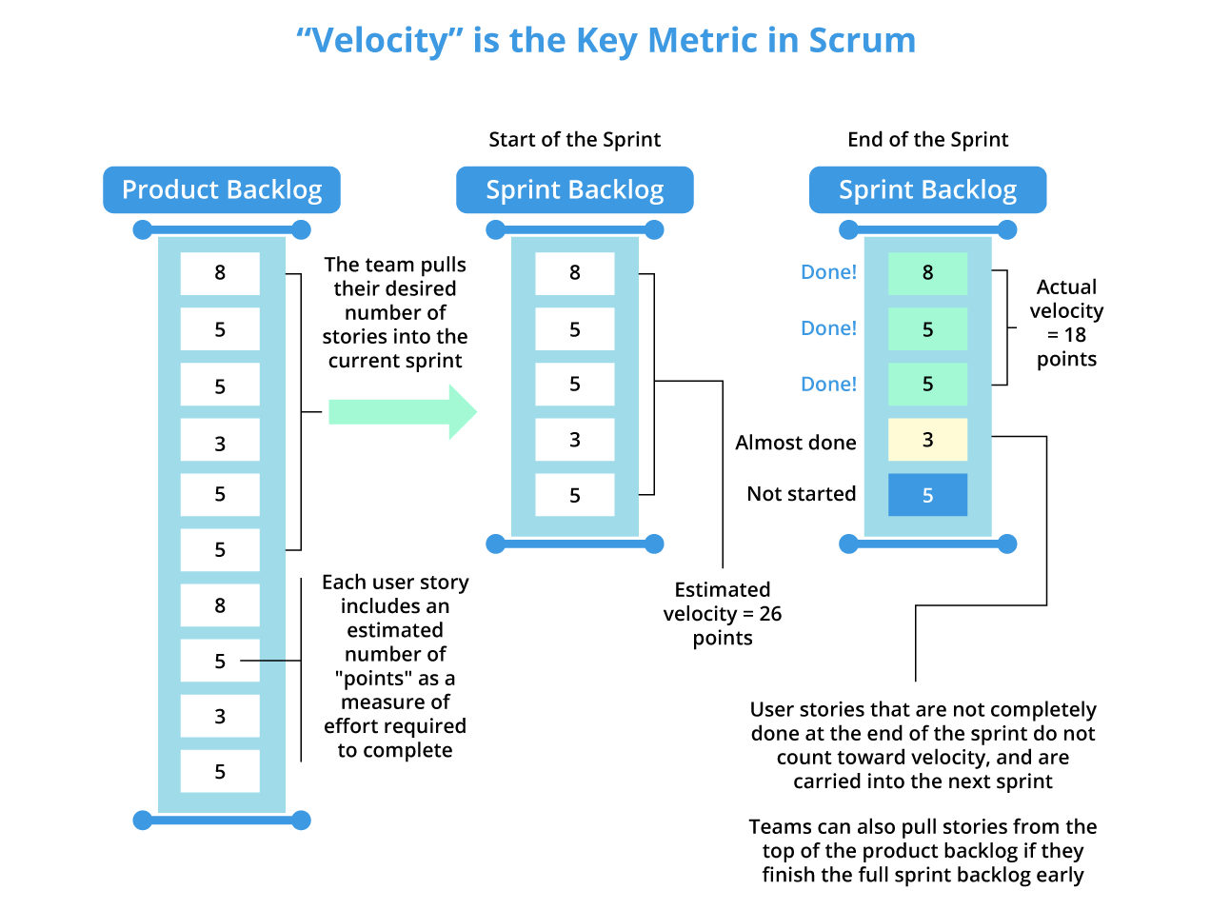
velocity

Slide 40
Product backlog
Discussed already

Slide 41
Sprint backlog
Discussed already

Slide 42
Agile methods across organizations
CULTURAL RESISTANCE :
ثقافتی مزاحمت سے مراد کسی تنظیم کے اندر افراد یا گروہوں کے اپنے کام کی ثقافت یا طرز عمل میں تبدیلی کے خلاف مزاحمت کرنے کا رجحان ہے۔ یہ مختلف طریقوں سے ظاہر ہو سکتا ہے، جیسے شکوک و شبہات، خوف، یا نئے طریقوں کو اپنانے میں ہچکچاہٹ
Project managers who do not have experience of agile methods may be reluctant to accept the risk of a new approach.
Large organizations often have quality procedures and standards that all projects are expected to follow and, because of their bureaucratic nature, these are likely to be incompatible with agile methods.
Agile methods seem to work best when team members have a relatively high skill level. However, within large organizations, there are likely to be a wide range of skills and abilities.
There may be cultural resistance to agile methods, especially in those organizations that have a long history of using conventional systems engineering processes.

Slide 43

Fourth Week Summary
Here is what we learned

Slide 44

Thank You!

